Slide 1
Herts and Essex Project Joint PPG Meeting
Aims of this evening’s meeting :
To explain the scope of the project
To give you an opportunity to give feedback and discuss

Slide 2
Locality Premises Challenges
Significant Growth in Population with new developments in North and South of town as well as other small pockets of development
Current Premises cannot accommodate growth in health needs of the town
South Street and Church Street not fit for modern day general practice
South Street has leases which are expiring
Parsonage current surgery space does not allow for growth

Slide 3
Why develop Herts and Essex?
Redevelopment of the Kitwood unit would allow for a modern and fit for purpose primary care hub
Enable collaborative working between the practices
Potential to increase Primary Care services out of hospital and reduce admissions
To utilise current void space which is currently a significant cost to the CCG
Currently there is ETTF funding to support the project

Slide 4
What will the project involve?
South Street will move out of the existing South Street premises to the Herts and Essex Community Hospital
South Street will retain a presence in the north of town (currently Bishops Park)
Parsonage will move into a larger space with an improved layout
Church Street will remain in Haymeads enabling collaborative working between the 3 practices

Slide 5
Concerns from Practices
Significant concerns regarding the additional cost in terms of rent and service charges
Concerns regarding timing and existing leases
Concerns regarding parking for patients and staff
Concerns regarding how Parsonage surgery will operate while building works happening
Concerns regarding maintaining our identities while working together on delivering some services

Slide 6
What will change ? Short term
South Street, Parsonage and Church Street will remain as separate surgeries within the H&E building
The practices will be able to start working together more collaboratively on projects with potential to deliver same day / urgent appointments and some chronic disease clinics together
Closer working with other providers at HEH

Slide 7
Longer term plans
The project will deliver improved services for existing patients and allow for some expansion
Other projects need to be implemented alongside the HEH project to meet the needs of the growing population
Development of a clear premises strategy for the town
Collaborative working

Slide 8
Timescale
Funding has already been secured via the ETTF but this is time limited
Plans have been drawn up – to be reviewed
Building work could be completed as early as May 2020

Slide 9
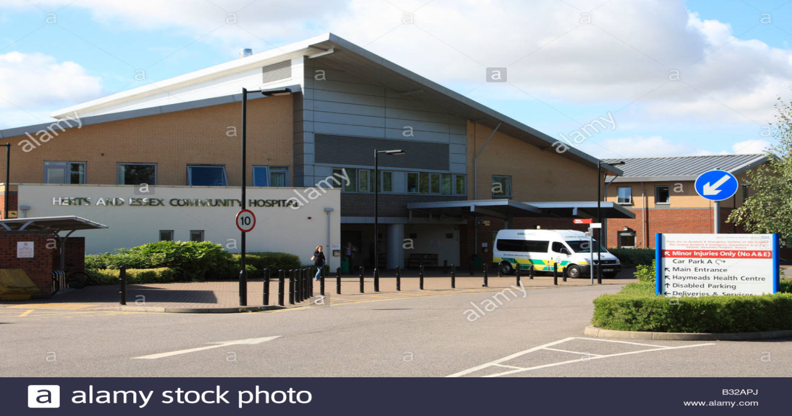
Discussion and Questions

